Slide 1
Multiple Regression
Vera Hollink
2025

Slide 2
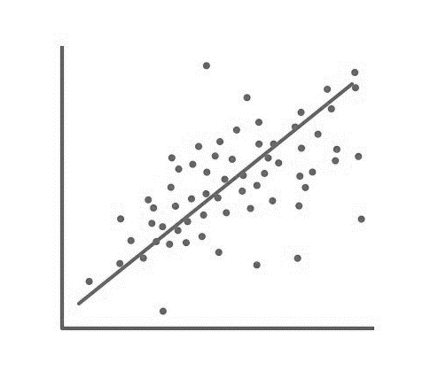
Summary last class

Slide 3
What is regression/prediction?
Regression Line or Estimated Regression Equation (ERE):
#Clients | Time (ms)
15 | 855
60 | 3214
32 | 1680
12 | 693
4 | 301

Slide 4
Residuals
Difference between predicted value and actual value: prediction error

Slide 5
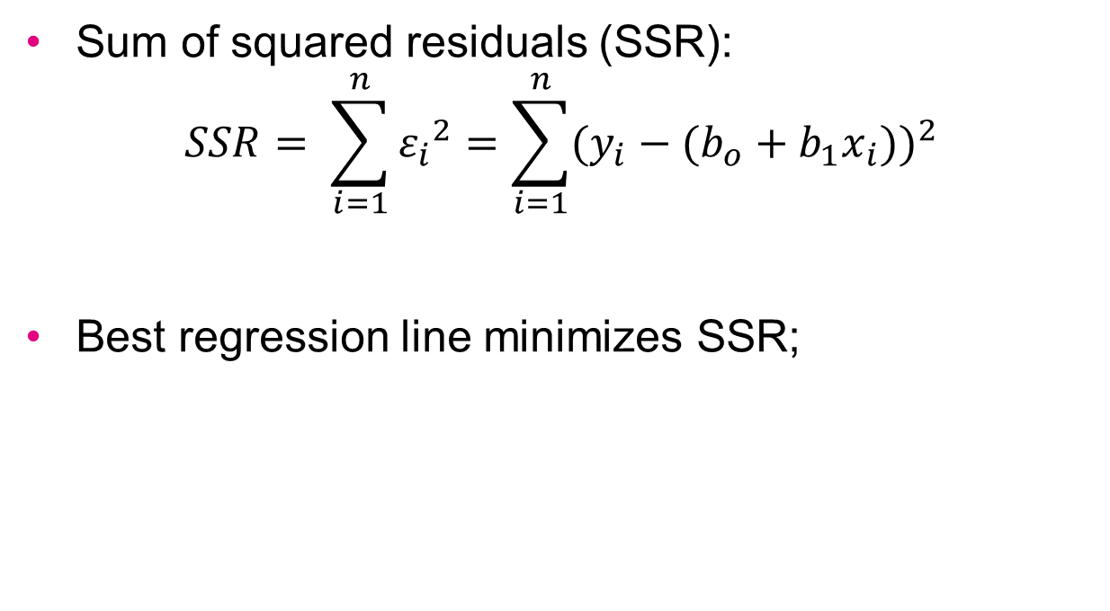
Least squares regression line
Sum of squared residuals (SSR):
$$SSR= \sum_{i=1}^{n}{{ε_{i}}^{2}}=\sum_{i=1}^{n}{{({y_{i}−(b}_{o}+b_{1}x_{i}))}^{2}}$$
Best regression line minimizes SSR;

Slide 6
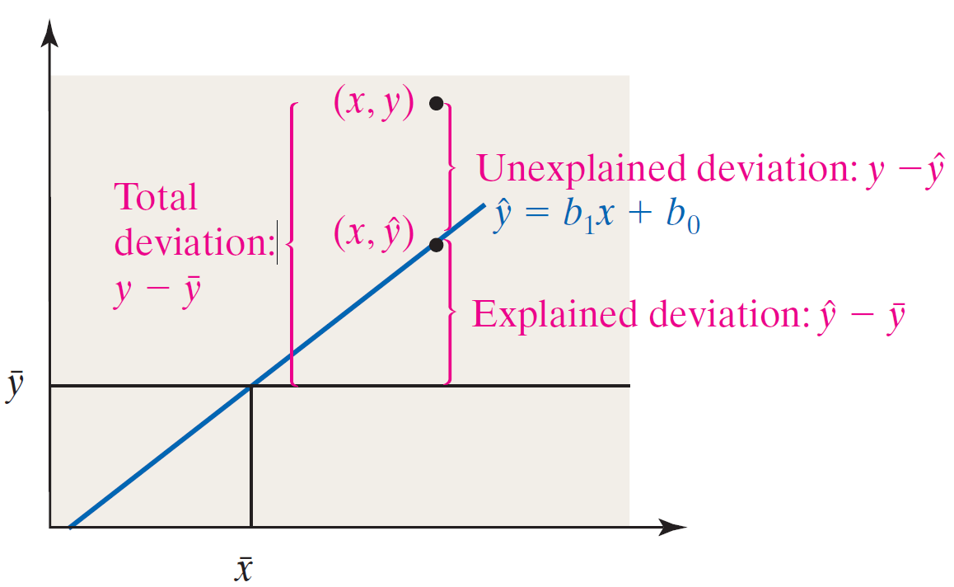
How good is the model?
Coefficient of Determination R²:
proportion of variance in y explained by ERE

Slide 7
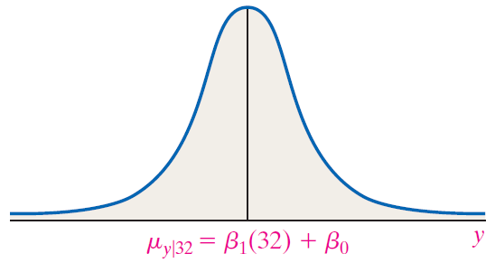
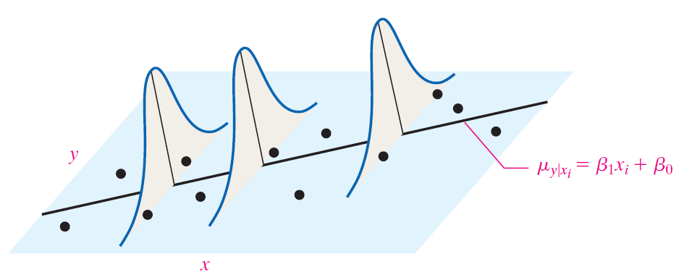

Regression Model Assumptions
For any x-value, y-values are normally distributed
Mean: $μ_{y|x}=β_{1}x+β_{0}$
Standard deviation: $σ=s_{e}$

Slide 8
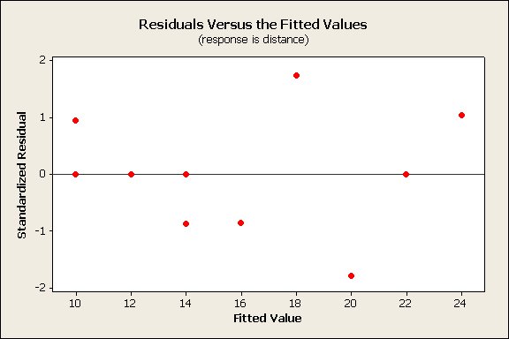
Verify model assumptions
Plot Standardized Residuals vs Predicted Values
Regression line (ERE) shown as horizontal line
Pattern in residuals → regression assumptions violated

Slide 9
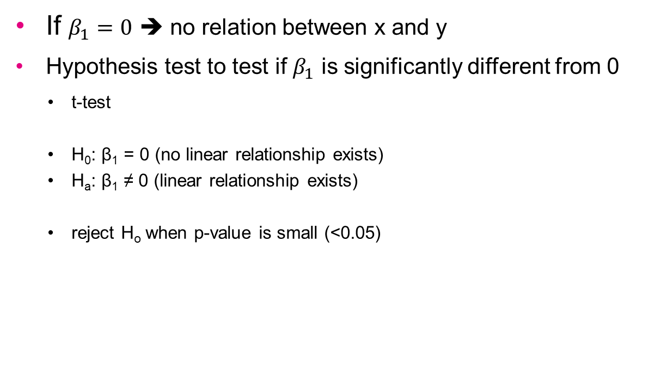
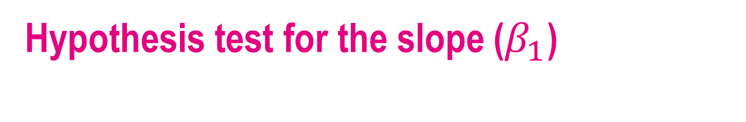
Hypothesis test for the slope ($β_{1}$)
If $β_{1}=0$ ➔ no relation between x and y
Hypothesis test to test if $β_{1}$ is significantly different from 0
t-test
H₀: β₁ = 0 (no linear relationship exists)
H_{a}: β₁ ≠ 0 (linear relationship exists)
reject H_{o} when p-value is small (<0.05)

Slide 10
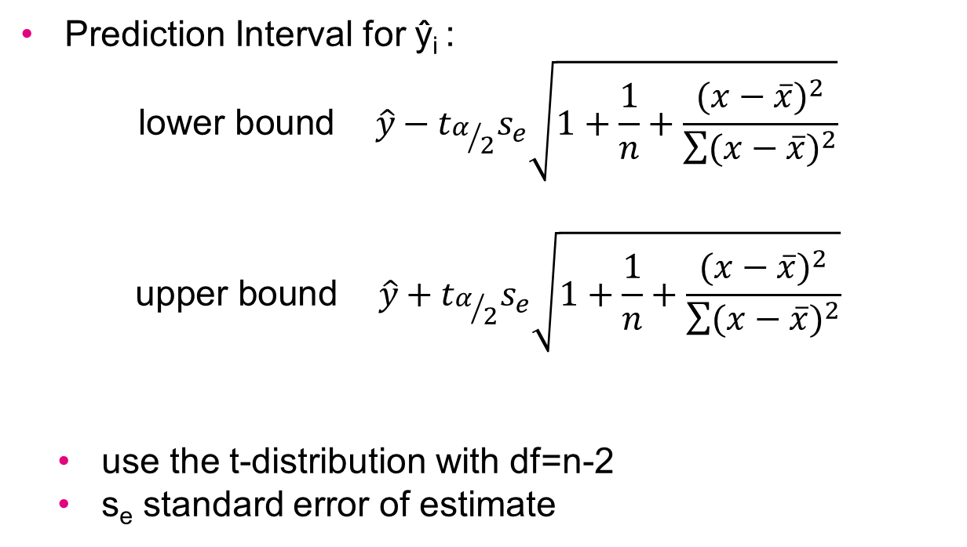
Prediction Interval
Prediction Interval for ŷ_{i} :
$$\text{lower} \text{bound} \hat{y}−t_{α/2}s_{e}\sqrt{1+\frac{1}{n}+\frac{{(x−\overline{x})}^{2}}{\sum{{(x−\overline{x})}^{2}}}}$$
$$\text{upper} \text{bound} \hat{y}+t_{α/2}s_{e}\sqrt{1+\frac{1}{n}+\frac{{(x−\overline{x})}^{2}}{\sum{{(x−\overline{x})}^{2}}}}$$
use the t-distribution with df=n-2
s_{e} standard error of estimate

Slide 11
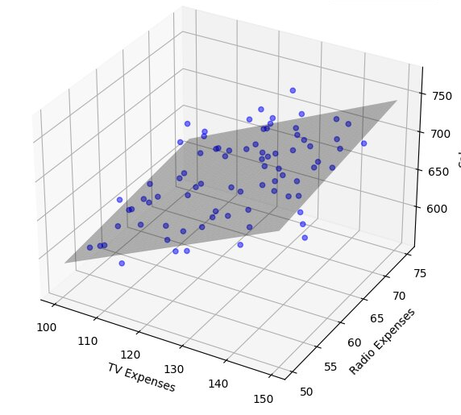
Multiple Regression

Slide 12
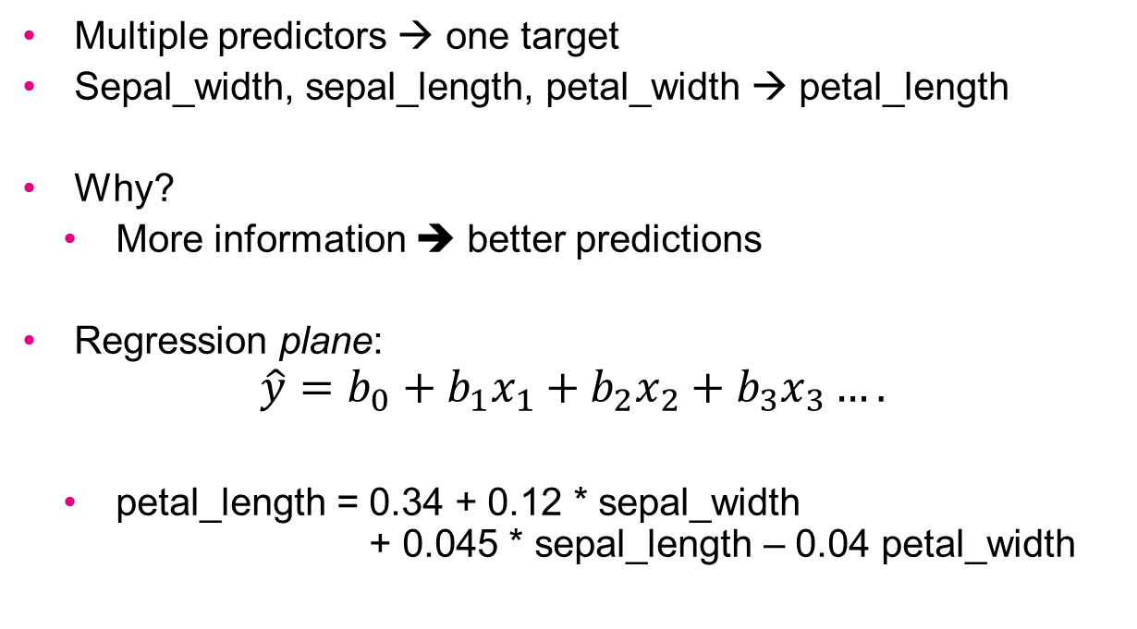
Multiple regression
Multiple predictors → one target
Sepal_width, sepal_length, petal_width → petal_length
Why?
More information ➔ better predictions
Regression plane:
$$\hat{y}=b_{0}+b_{1}x_{1}+b_{2}x_{2}+b_{3}x_{3}….$$
petal_length = 0.34 + 0.12 * sepal_width + 0.045 * sepal_length – 0.04 petal_width

Slide 13
Regression equation interpretation
petal_length = 0.34 + 0.12 * sepal_width + 0.045 * sepal_length – 0.04 petal_width
Interpretation:
If sepal_width is increased by 1, then, on average, petal_length increases by 0.12 provided that sepal_length and petal_width are not changed
If sepal_length is increased by 1, then, on average, petal_length increases by 0.045 provided that sepal_width and petal_width are not changed
…

Slide 14
Dummy/indicator variables
What do we do with nominal variables?
Name | Species | Weight | Height | Sex
Bobo | Guinea pig | 150 | 12 | Male
Johnny | Cat | 2120 | 35 | Male
Noeshka | Cat | 1905 | 32 | Female
Pip | Dog | 1028 | 102 | Female
One-hot encoding

Slide 15
Name | Species | Weight | Height | Sex
Bobo | Guinea pig | 150 | 12 | Male
Johnny | Cat | 2120 | 35 | Male
Noeshka | Cat | 1905 | 32 | Female
Pip | Dog | 1028 | 102 | Female
Name | Species_ guinea_pig | Species_ cat | Species_ dog | Weight | Height | Sex
Bobo | 1 | 0 | 0 | 150 | 12 | 0
Johnny | 0 | 1 | 0 | 2120 | 35 | 0
Noeshka | 0 | 1 | 0 | 1905 | 32 | 1
Pip | 0 | 0 | 1 | 1028 | 102 | 1
Weight = 12.2 * Height - 0.01 sex – 0.3 species_cat + 1.0 species_dog – 0.30 species_guinea_pig

Slide 16
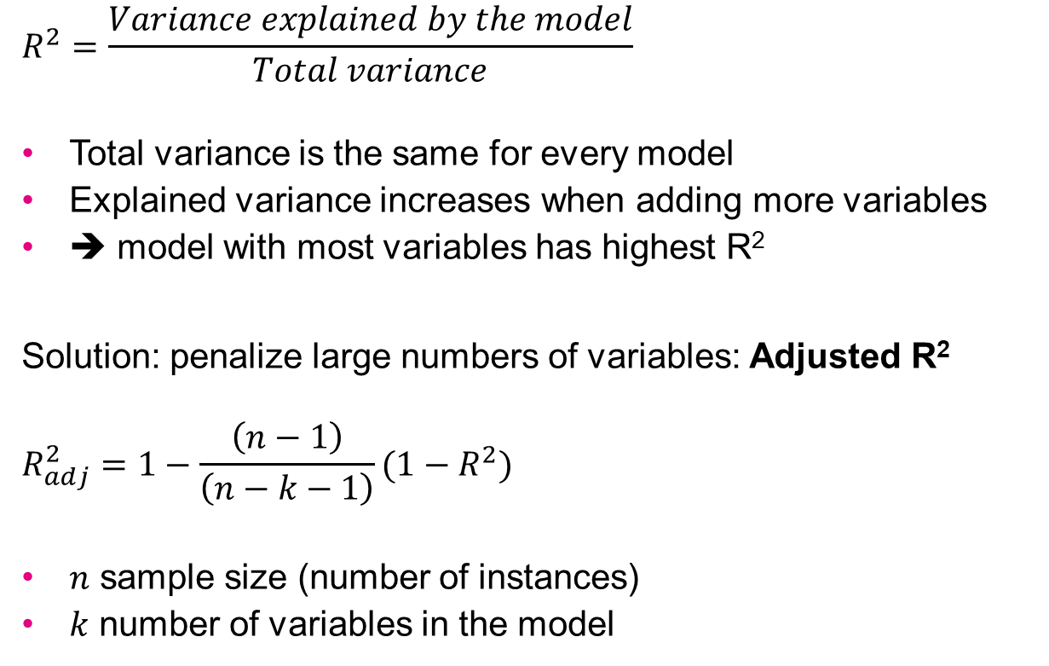
How good is the model?
$$R^{2}=\frac{Variance explained by the model}{Total variance}$$
Total variance is the same for every model
Explained variance increases when adding more variables
➔ model with most variables has highest R²
Solution: penalize large numbers of variables: Adjusted R²
$$R_{adj}^{2}=1−\frac{\left(n−1\right)}{\left(n−k−1\right)}(1−R^{2})$$
$n$ sample size (number of instances)
$k$ number of variables in the model

Slide 17
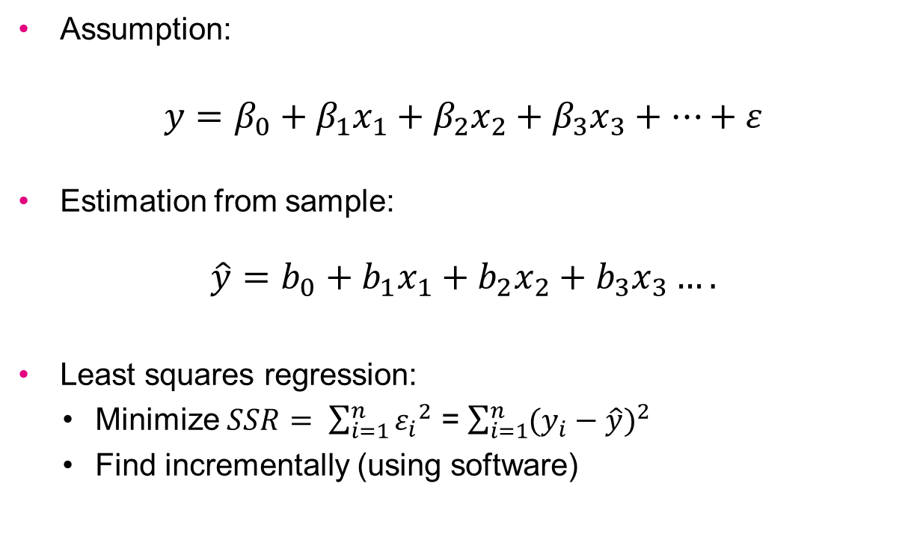
Multiple regression model
Assumption:
$$y=β_{0}+β_{1}x_{1}+β_{2}x_{2}+β_{3}x_{3}+…+ε$$
Estimation from sample:
$$\hat{y}=b_{0}+b_{1}x_{1}+b_{2}x_{2}+b_{3}x_{3}….$$
Least squares regression:
Minimize $SSR= \sum_{i=1}^{n}{{ε_{i}}^{2}}$ = $\sum_{i=1}^{n}{{(y_{i}−\hat{y})}^{2}}$
Find incrementally (using software)

Slide 18

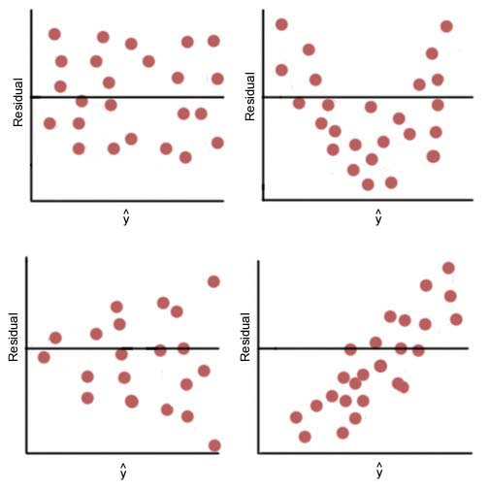
Verify model assumptions
Plot Standardized Residuals vs fitted value
Pattern in residuals → regression assumptions violated
For each predictor variable:
Plot Standardized Residuals vs variable value
Pattern in residuals → regression assumptions violated
x_{i}
x_{i}
x_{i}
x_{i}

Slide 19
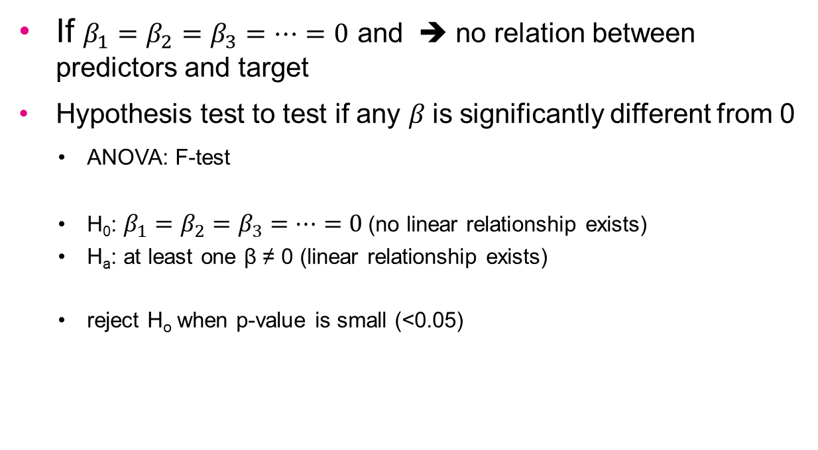
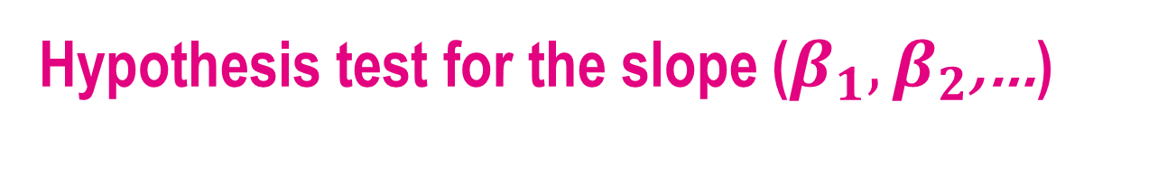
Hypothesis test for the slope ($β_{1},β_{2}$,…)
If $β_{1}=β_{2}=β_{3}=…=0$ and ➔ no relation between predictors and target
Hypothesis test to test if any $β$is significantly different from 0
ANOVA: F-test
H₀: $β_{1}=β_{2}=β_{3}=…=0$ (no linear relationship exists)
H_{a}: at least one β ≠ 0 (linear relationship exists)
reject H_{o} when p-value is small (<0.05)

Slide 20
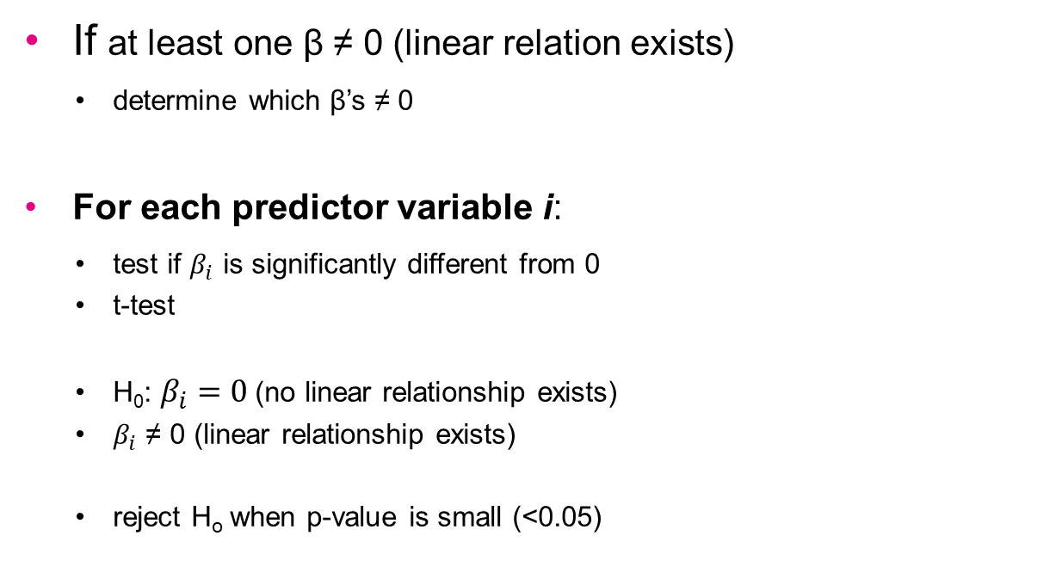
Hypothesis test for the slope ($β_{1},β_{2}$,…)
If at least one β ≠ 0 (linear relation exists)
determine which β’s ≠ 0
For each predictor variable i:
test if $β_{i}$ is significantly different from 0
t-test
H₀: $β_{i}=0$ (no linear relationship exists)
$β_{i}$ ≠ 0 (linear relationship exists)
reject H_{o} when p-value is small (<0.05)

Slide 21
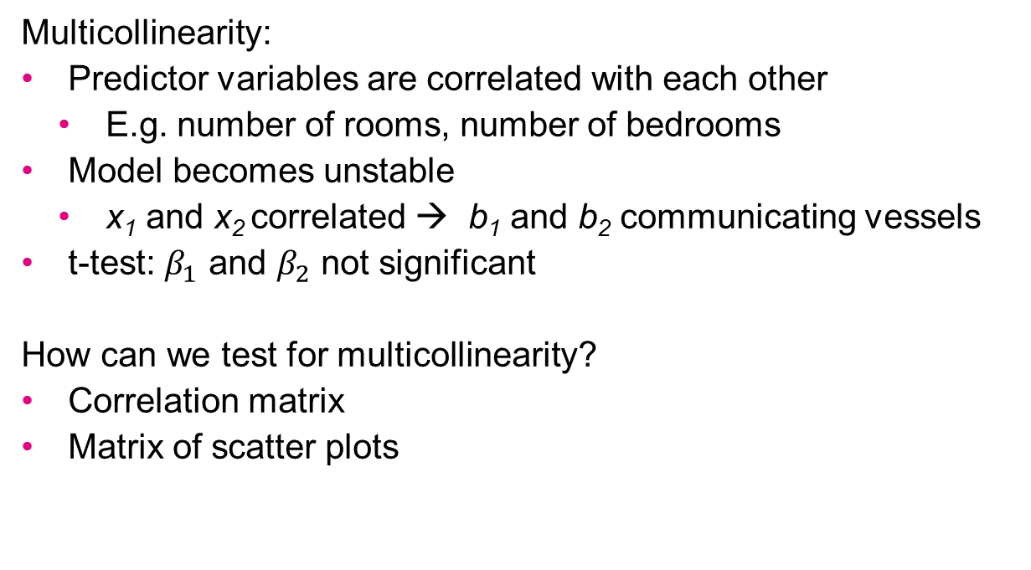
Multicollinearity
Multicollinearity:
Predictor variables are correlated with each other
E.g. number of rooms, number of bedrooms
Model becomes unstable
x₁ and x₂ correlated → b₁ and b₂ communicating vessels
t-test: $β_{1}$ and $β_{2}$ not significant
How can we test for multicollinearity?
Correlation matrix
Matrix of scatter plots

Slide 22
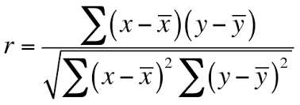
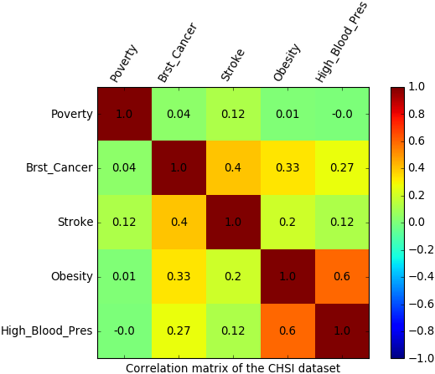
Correlation matrix
Pearson’s correlation coefficient

Slide 23
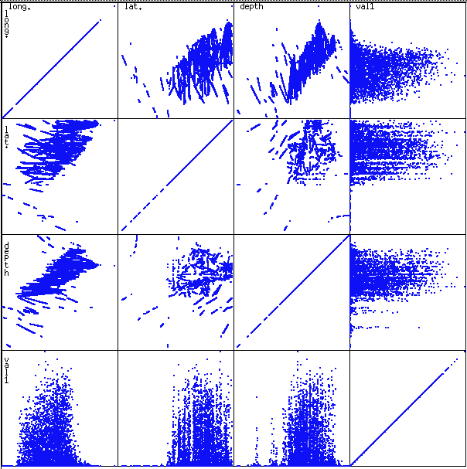
Matrix of scatter plots

Slide 24
Multicollinearity
x₁ , x₂ ,…, correlated
Solution?
Dimension reduction: reduce the number of variables
Manually remove all but one of the correlated predictors
Automatic variable selection
Principle Component Analysis

Slide 25
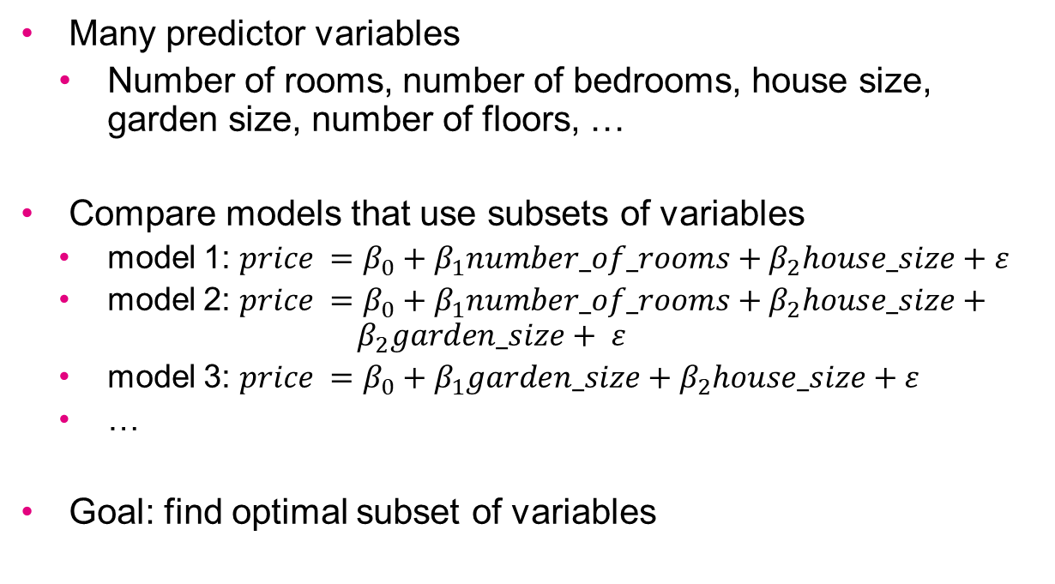
Variable selection
Many predictor variables
Number of rooms, number of bedrooms, house size, garden size, number of floors, …
Compare models that use subsets of variables
model 1: $price =β_{0}+β_{1}number_of_rooms+β_{2}house_size+ε$
model 2: $price =β_{0}+β_{1}number_of_rooms+β_{2}house_size+{ β}_{2}garden_size+ ε$
model 3: $price =β_{0}+β_{1}garden_size+β_{2}house_size+ε$
…
Goal: find optimal subset of variables

Slide 26
The Partial F-Test
Model with x₁,…,x_{p} predictors,
Consider adding predictor x_{p+1}
Additional variability explained significant?
Hypotheses for Partial F-Test:
H_{o}: x_{p+1} does not contribute significantly to model
H_{a}: x_{p+1} does contribute significantly to model

Slide 27
Variable Selection Methods
Variable selection methods:
All subsets
Forward Selection
Backwards Elimination
Stepwise Selection

Slide 28
All-Possible-Subsets Procedure
Create a subsets of predictor set
Do regression for each subset
Compute statistics (e.g. R²_{adj}) for all subsets
Ensures best model
Why not useful in practice?
p predictors leads to 2^{p-1} subsets
p = 5 → 31 models, p = 10 → 1023 models, p = 20 → 1,048,575 models!
Better ideas?

Slide 29

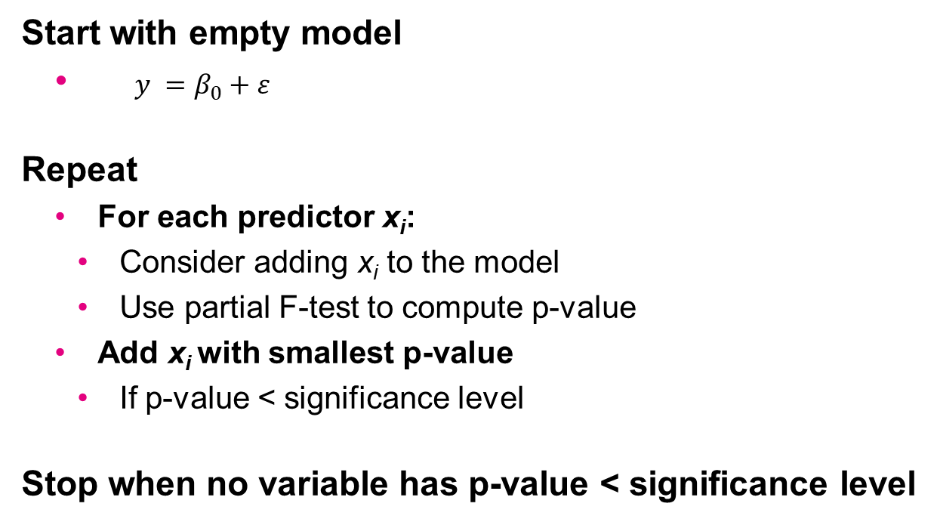
Forward Selection Procedure
Start with empty model
$y =β_{0}+ε$
Repeat
For each predictor x_{i}:
Consider adding x_{i} to the model
Use partial F-test to compute p-value
Add x_{i} with smallest p-value
If p-value < significance level
Stop when no variable has p-value < significance level

Slide 30

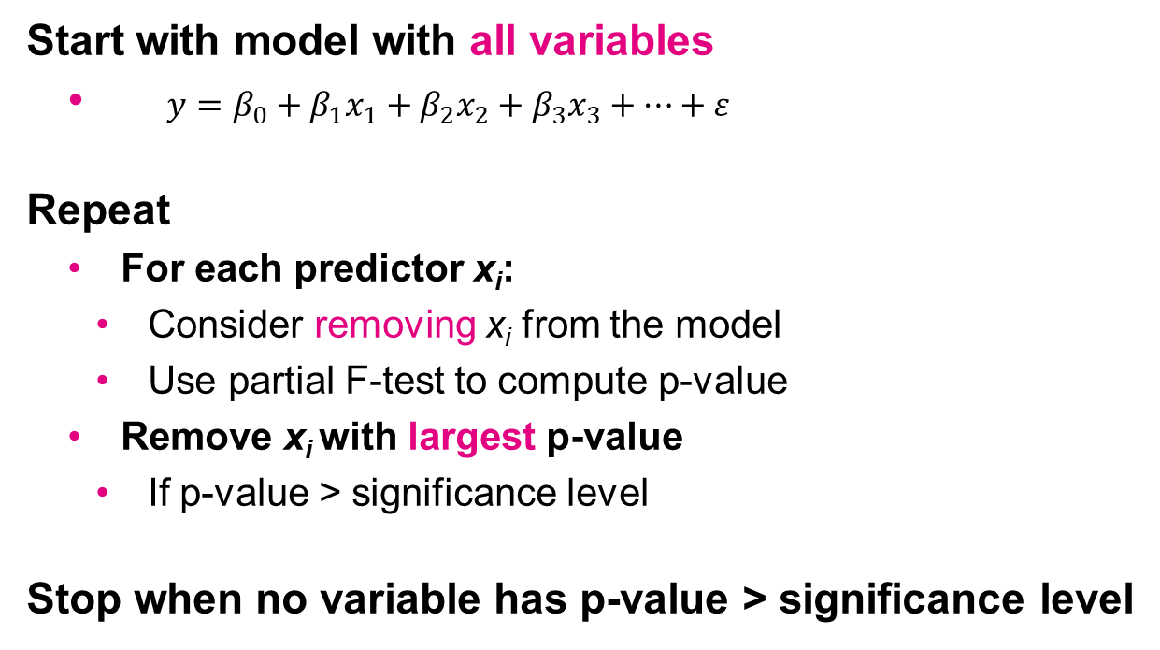
Backwards Elimination Procedure
Start with model with all variables
$y=β_{0}+β_{1}x_{1}+β_{2}x_{2}+β_{3}x_{3}+…+ε$
Repeat
For each predictor x_{i}:
Consider removing x_{i} from the model
Use partial F-test to compute p-value
Remove x_{i} with largest p-value
If p-value > significance level
Stop when no variable has p-value > significance level

Slide 31
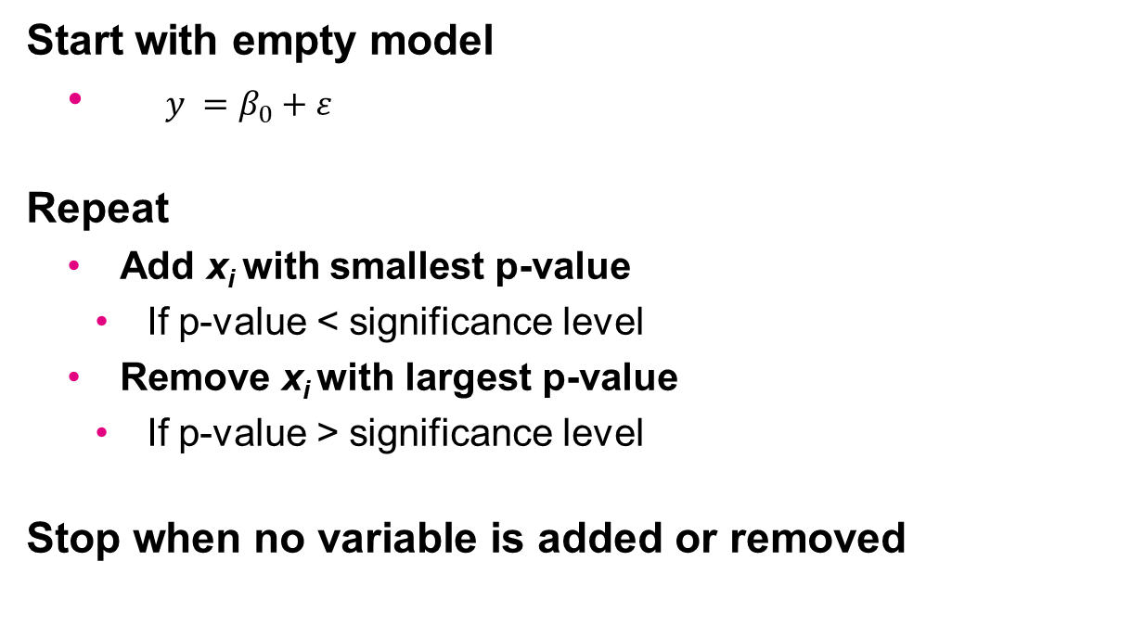
Stepwise Procedure
Start with empty model
$y =β_{0}+ε$
Repeat
Add x_{i} with smallest p-value
If p-value < significance level
Remove x_{i} with largest p-value
If p-value > significance level
Stop when no variable is added or removed

Slide 32

Multiple Regression with Statsmodels
Demo script Regression.py

Slide 33
Multicollinearity
x₁ , x₂ ,…, correlated
Solution?
Dimension reduction: reduce the number of variables
Manually remove all but one of the correlated predictors
Automatic variable selection
Principle Component Analysis
Next class

Slide 34
And now…
Exercises part 2:
Univariate Linear Regression
Multivariate Regression

